Slide 1
GridAI
Josh Clinton - Frontend Lead
Tanay Parikh - Data Lead
Ryan Herren - Machine Learning Lead
Elvis Kimara - Voice Assistant Lead
Rolf Anderson - CI/CD & Testing Lead
Advisor- Ravikumar, Gelli
Notes:
Ryan

Slide 2
Team Introductions
Notes:
Ryan

Slide 3
Problem Statement
Power Grids:
Society depends on them
Increasingly complex
Even small issues can cause large outages
Grid Operators Need Better Tools
Visualize and monitor
Predict future grid status and anomalies
Notes:
Ryan
NEXT: ROLF - PROJECT VISION

Slide 4
Project Vision
Improve grid management efficiency
Provide visibility into grid systems
Detect anomalies
Prevent power disruption
Target users:
Energy companies
Governments
Notes:
Rolf
NEXT: ROLF - CONCEPTUAL SKETCH
What is the project attempting to accomplish?
•Who cares? Whose life would be improved? Use cases?
•A very high level 1-2 sentence approach
•1-2 slides, 1-2 minutes

Slide 5
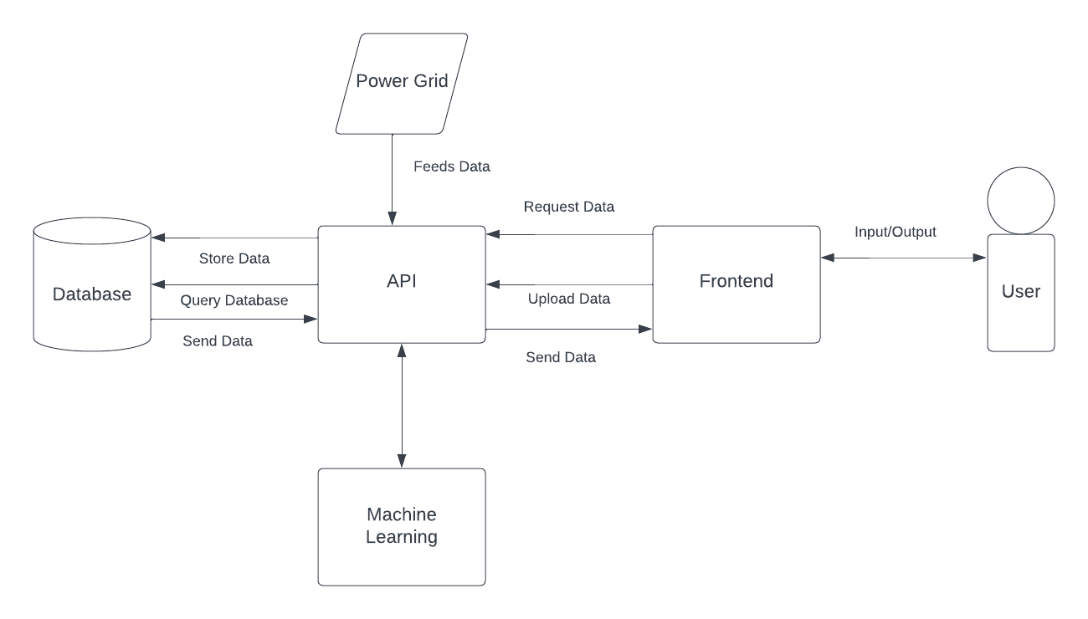
Visual Sketch
Notes:
Rolf
NEXT: FUNCTIONAL REQUIREMENTS
A concept visual that captures most of the elements – what is being designed? Who is the targeted clientele? What is unique about the approach?
•1 slide, 1-2 minutes

Slide 6
Requirements: Functional
Real-time Grid Analysis
Predict state of every node for the next hour
Predict anomalies
Leverage ML to analyze anomalies and provide regulation
Tensorflow(supervised learning) + Powergym(Reinforcement Learning)
Visualize data
Next.Js
Runs and Deploys In Cloud
Google Cloud Platform (GCP)
Use google Voice Assistant
Using google action console, and app actions
Notes:
Rolf
NEXT: NON-FUNCTIONAL REQUIREMENTS
Functional
•Non-functional
•Technical and/or other constraints
Where does it run?
•1-2 slides, 2 minutes

Slide 7
Requirements: Non Functional
Effective Visualization
Intuitive interface
Powerful management without being overwhelming
System Performance
Little to no wait for desired information
Voice assistant is reasonably fast
Easy to Maintain
Modular design
Automated testing and deployment of services
Notes:
Rolf
NEXT: INTRO TO SYSTEM DESIGN OVERVIEW

Slide 8
System Design
Microservices
Deployed in Docker containers to GCP
Components:
Frontend
API
Databases
ML
Assistant
Notes:
Rolf
NEXT: ROLF - API

Slide 9
System Design (API)
Central API Of System
Golang Based
Handles Interservice Communication
Notes:
Rolf
NEXT: JOSH - FRONTEND

Slide 10
System Design (Frontend)
Next.js based microservice
Map Visualization
Mapbox
View status and data of Nodes
Overview of the grid’s state
User Profiles
Set alerts and filters
Save settings
Data Upload
Notes:
Josh
NEXT: TANAY - DB

Slide 11
System Design (Databases)
Neo4j AuraDB (Graph Database)
Static information on the geographical node data
Types In NodeData
nodeID
InfluxDB (Time-series)
Hourly Power Data(time-series)
BusID
Notes:
Tanay
Neo4j AuraDB (Graph Database)
Static information on the geographical node data
Types In nodedata
nodeID
InfluxDB (Time-series)
Hourly power data(time-series)
BusID
NEXT: RYAN - ML

Slide 12
System Design (ML)
TensorFlow (two existing models)
Supervised learning
Predict the next hour for every node
Detect anomalies in node and system behavior
PowerGym
Reinforcement Learning
Volt-var control:
Minimizing voltage violations, control loss, and power loss
Notes:
Ryan
Machine Learning
Supervised vs Unsupervised vs Reinforcement Learning
Supervised (labeled) vs Unsupervised (unlabeled) vs Reinforcement (reward/punishment)
NEXT ELVIS - ASSISTANT

Slide 13
System Design (Assistant)
Improves accessibility of UI
Supports voice and text as input and output
Leverage Google speech-to-text, Google Action console
Query data based on parsed commands
Notes:
Elvis
NEXT - PROTOTYPE IMPLEMENTATIONS

Slide 14
Prototype Implementations
Last Year:
Created Software Components (frontend, api, database)
Completed Basic Functionality
This year:
Transitioned to New Environments
Improving and making the functionalities closer to industry standards (integration, no hard coded values)
Notes:
Elvis
•Any prototype implementations?
•Any results?
Uploading data, how they did it last year and how we want to do this year
ML models how they did it last year and how we want to do this year
•1-3 slides, 1-2 minutes
NEXT - DESIGN COMPLEXITY

Slide 15
Design Complexity
Voice Assistant
Google is deprecating google conversational actions by June 2023
Implementing voice assistants won't be as easy as it was in the past
ML Algorithm Choices
Neural networks could provide better results than alternatives
Dozens of different metrics provided by API
Reinforcement learning using PowerGym
Will require many iterations of rewards/punishments for training
Notes:
elvis
•What made your design hard?
Microservice and docker
Google assistant
•What kind of design iterations were needed?
•1 slide, 1-2 minutes
NEXT RYAN - PROJECT PLAN

Slide 16
Project Plan
ML Tasks
Create reinforcement learning algorithm for volt-var control using PowerGym
Replace linear regression with neural network model for prediction model
Frontend Tasks
Redesign UI
Implement a filesystem that works with the backend
Implement Machine Learning and Voice Assistance
API Tasks
Create routes to cover all interservice communication
Database Tasks
Upload local DSS Files
File Management System
Notes:
Ryan
•Any market survey or other quantitative/qualitative assessment of need
•Tasks?
•Risks and mitigation plan (potentially task-wise)
•1-2 slides, 1-2 minutes
•
NEXT TANAY - SCHEDULE AND MILESTONES

Slide 17
Schedule and Milestones
Project Metrics:
All nodes are visible and accessible on UI
90% anomaly classification success
100% code coverage in testing
Milestones:
Functional voice assistant
Data upload/Export methods
Implement real-time data visualization
Notes:
Tanay
Project Metrics:
All nodes are visible and accessible on UI
90% anomaly classification success
100% code coverage in testing
Milestones:
Functional voice assistant
Data upload/Export methods
Implement real-time data visualization *
And now i going to give to rolf and he’ll talk about risk

Slide 18
Risks and Mitigation
Cybersecurity Threats
Implement information security features
Follow industry best practices
Unsatisfactory ML Model Performance
Further train and optimize model
Evaluate if current method is effective
Key Person Risk
Decentralize development work
Frequent code reviews or knowledge transfer sessions
Notes:
Rolf
NEXT - TEST PLAN

Slide 19
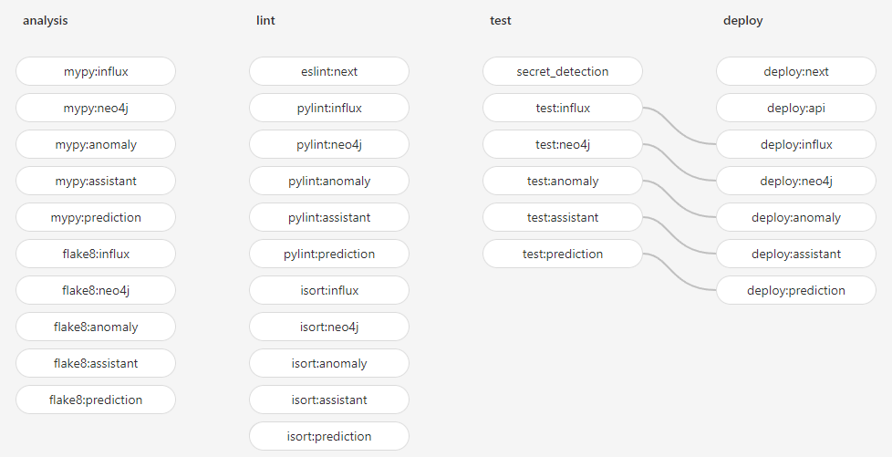
Test Plan
Use Gitlab CI/CD for testing
Unit Testing and Linting
PyLint, PyTest, Jest
Mypy (Type Checking)
Flake8 (Style Enforcement)
PyTest (Interface Testing)
Security testing
Safety
Integration testing
Cypress
Acceptance testing
Client demos
Notes:
Rolf
NEXT - JOSH, PREVIOUS FRONT END DESIGN
How is testing performed? Simulation, emulation, actual platform, hybrid?
•Component/Unit testing (tied to requirements)
•Interface/integration testing
•System level testing/Acceptance testing – justified w.r.t. requirements
•1-3 slides, 2-3 minutes

Slide 20
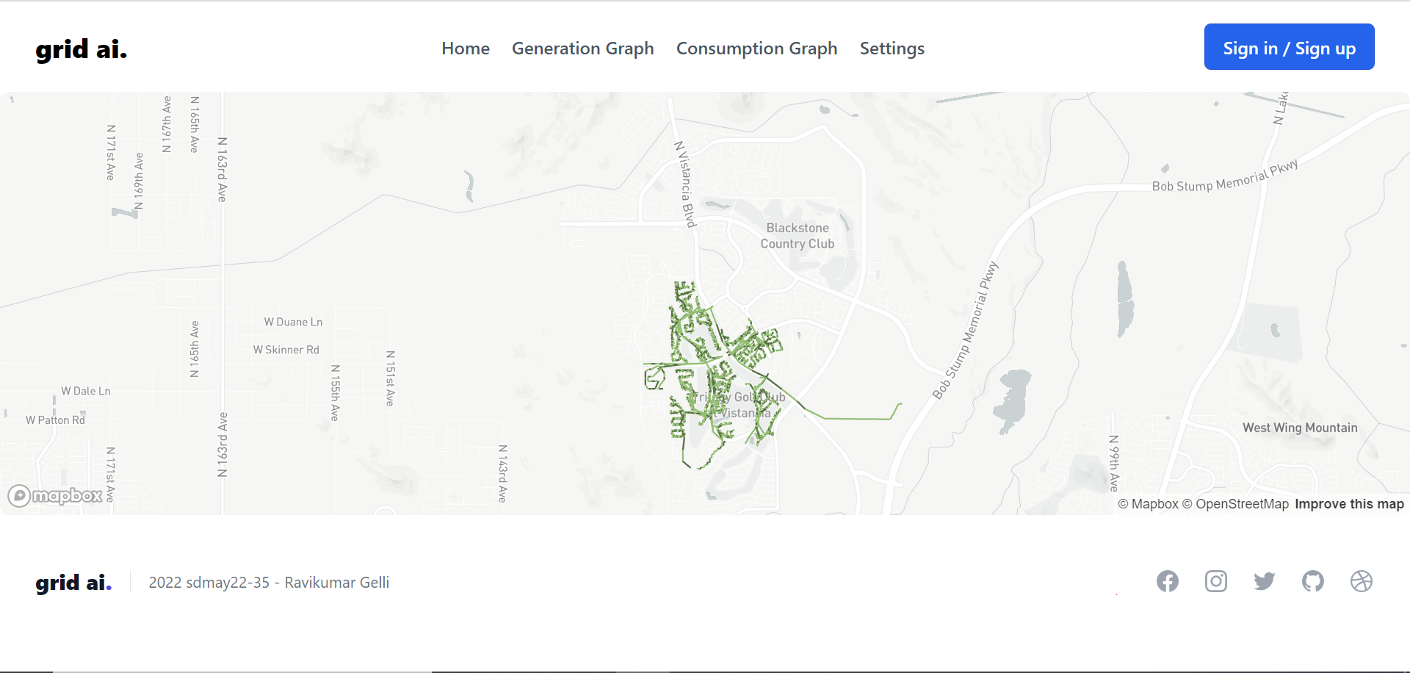
Previous Design

Slide 21
Front-End UI Wireframes
Notes:
Josh

Slide 22
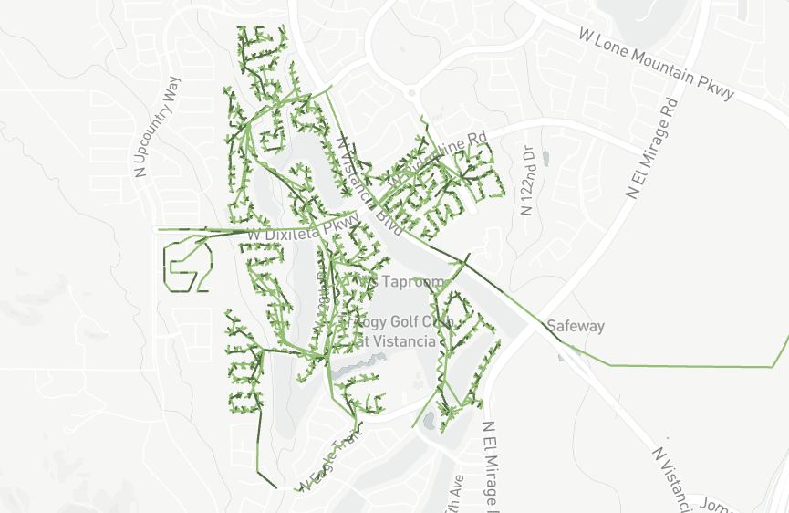
GridAI
Login/Signup
Settings
*Some Logo
Notes:
Josh
Next: Main-Page after Authentication

Slide 23
GridAI
Generation
Graph
Consumption
Graph
Files
ML/Anomalies
Voice Assist
Sign Out
Settings
Notes:
Josh
Next: Filesystem

Slide 24
Display contents of file
Home
Files
<Folder1
>file1
>file2
>file3
>file4
>file5
>file6
>file7
>file8
Import Files
Export Files
Notes:
Josh
Next: Consumption Graph with third column and layers

Slide 25
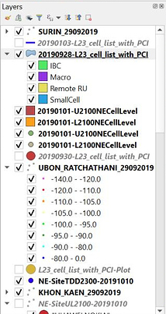
Home
Consumption
Graph
List of Filters/
Options
-
-
-
-
-
-
Node Data:
Notes:
Josh
Next- Conclusions by Elvis

Slide 26
Conclusions
Transitioning from Planning to Implementation Phase
Long-Term Goals
Maintain and Update Existing Codebase
Redesign Frontend
Useful Voice Assistant
Efficient ML Models
Complete End-to-End Automated Testing
File management system for the DSS file for each users
Notes:
elvis
•Where are you in your schedule?
•Next semester’s plans - have a file management system for each user
•Individual team members contributions delineated
•1 slide, 1-2 minutes

Slide 27
Questions ?
Notes:
elvis

