Slide 1
Grid AI sdmay23-38
Joshua Clinton
Tanay Parikh
Elvis Kimara
Rolf Anderson
Ryan Herren
Notes:
everyone

Slide 2
Agenda
Project Overview
Areas of Professional Responsibilities
Strengths
Weaknesses
Biggest Ethical Challenge + Solution
Notes:
Ryan

Slide 3
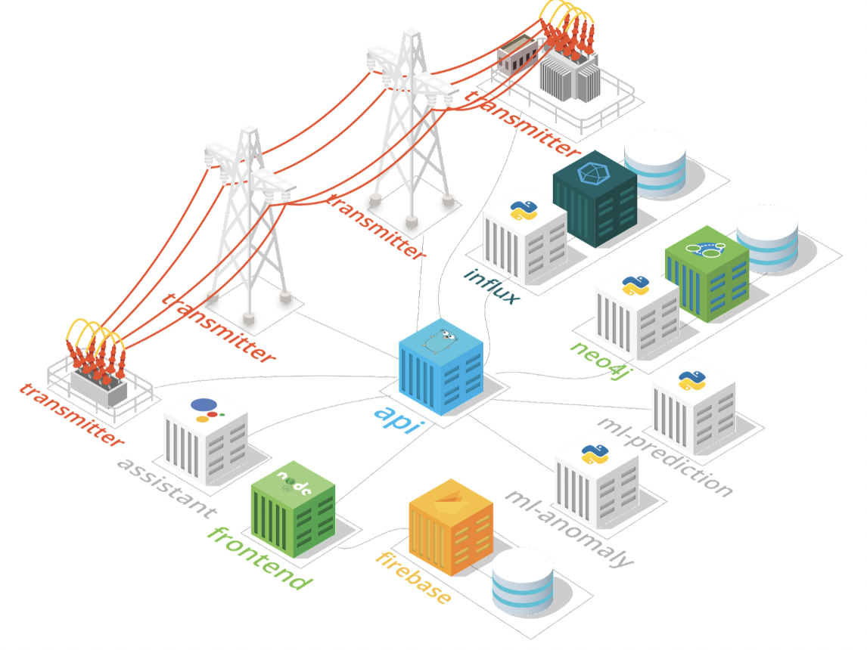
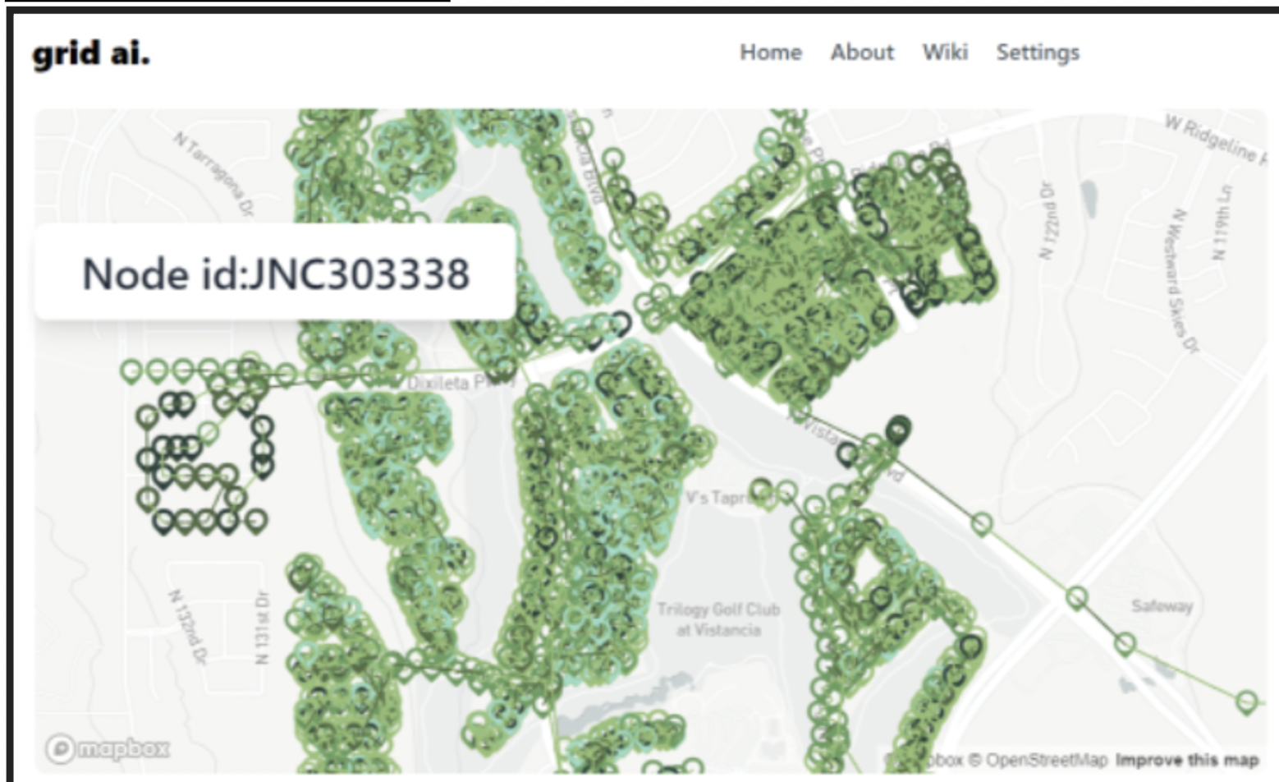
GridAI
Our project:
Provide Insight power grid data using ML
Prevent outages, predict anomalies
Impacted Groups
Power grid companies and technicians
Major components
Frontend, Voice Assistant, ML
Api, firebase, neo4j, database
Notes:
Ryan

Slide 4
Areas of Professional Responsibility
Work Competence
We need technical experience to make an AI agent, even though we are all SE and CPRE majors (medium)
Financial Responsibility
Relevant since we’ll have to have a minimum viable product by the end of the year (medium)
Communication Honesty
Very relevant since we’ll have to work closely with our client that’s on campus (high)
Health, safety, and well-being
Important because our project should be safe and secure for the users (high)
Property Ownership
All the data we use is sensitive. It's important to only use it for this project. (high)
Sustainability
Having this technology to help the power grid will help the future generations who are becoming more and more reliant on power. (high)
Social Responsibility
Very relevant since our project seeks to have a positive impact on different communities (high)
Notes:
Josh

Slide 5
Doing Good
Communication: Our team has really focused on the importance of effective communication as one of our major strengths.
We have:
Discord for team texts and meeting calls
Team email address that keeps everyone updated with what’s going on
On campus client that’s a research professor therefore easily accessible
In person meetings with team and client every other week so we don’t lose track.
Shared google drives, and notes to help stay on board
Notes:
Elvis

Slide 6
Doing Bad
Work Competence: As a team we have little knowledge with Machine Learning so a large portion of our job is learning what to do.
We hope to improve on this over time.
Notes:
Elvis/Tanay

Slide 7
Biggest Ethical Challenge: Keeping the Lights On
Power grid failures are dangerous
2003 Northeast Blackout: 90 deaths (Yale Environment Review)
2021 Texas Blackout: 246 deaths (Texas Department of State Health Services)
Millions of people rely on critical services that require a functioning power grid
Hospitals and pharmacies
Climate control
Food distribution and preparation
Lives are at stake if our project misses anomalies
Solutions:
Robust design
Implement fail-safe designs
Extensive unit and integration testing
Frequent code reviews and audits
Don’t ship code unless we are certain it will function as intended
Notes:
Rolf

Slide 8
Questions

Slide 9
References
https://environment-review.yale.edu/true-cost-power-outages-0
https://www.texasstandard.org/stories/texas-freeze-winter-storm-2021-death-count/

